Slide 1
ZOO MANAGEMENT SYSTEM
Submitted For partial Fulfillment For award for degree
M.C.A ( Master of Computer Application)
Subject name: Project Report & Viva
Submitted by:
Mr. Kanhaiya Govinda Chaudhari
Mr. Prajwal Santosh Mankar
Mr.Bhavesh Nitin Mahajan
Mr. Ajay Dileep Pawar
Mr.Pranil M. Bhavsar
Mr.Pankaj S. Patil

Slide 2
Contents
Introduction ∆ Snapshot
∆ Project Details ∆ Advantages
∆ How to system work. ∆ Applications
∆ Database design.
System vs
∆ Software requirement specification ∆ Future scope
∆ Conclusion
∆ Reference

Slide 3
INTRODUCTION
Zoological gardens provide an opportunity to open up a whole new world of curiosity and interest, and sensitize visitors regarding the value and need for conservation of wildlife.
Zoos were initially started for the entertainment of people. Gradually over the years, they have come to play an important role in conservation. The ultimate goal of zoos is the conservation of animals in the wild
This website educating people about wildlife and biodiversity conservation

Slide 4
FEATURES
We are here trying to make a project on Zoo Management System which is basically an application software where we can get information about wild life and as well as can manage the zoological garden
It’s a system of managing the animal records.
Here manage the ticket booking
Here Anyone can see which type of food and nutrition's taken by animals reach .
Here listed various type of animal adoption schemes anyone can easily adopt animals.
Here we listed pre-visit instruction and warning before visit visitor can understand easily.
If any one can have a query and help they directly contact with zoo authority

Slide 5
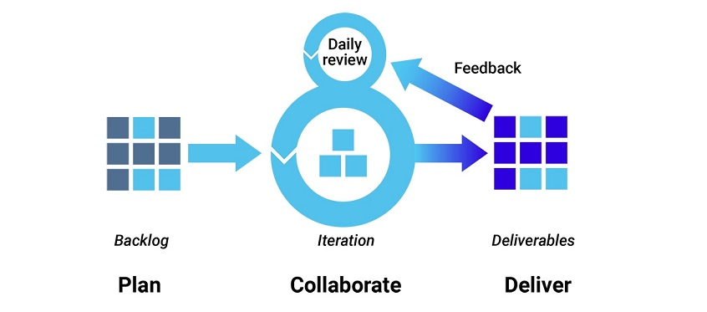
SOFTWARE PROCESS USING AGILE METHODOLOGY
1. Agile development methodology
Teams use the agile development methodology to minimize risk (such as bugs, cost overruns, and changing requirements) when adding new functionality. In all agile methods, teams develop the software in iterations that contain mini-increments of the new functionality. There are many different forms of the agile development method, including scrum, crystal, extreme programming (XP), and feature-driven development (FDD).

Slide 6
Pros: The primary benefit of agile software development is that it allows software to be released in iterations. Iterative releases improve efficiency by allowing teams to find and fix defects and align expectation early on. They also allow users to realize software benefits earlier, with frequent incremental improvements.
Cons: Agile development methods rely on real-time communication, so new users often lack the documentation they need to get up to speed. They require a huge time commitment from users and are labor intensive because developers must fully complete each feature within each iteration for user approval.
Agile development methods are similar to rapid application development (see below) and can be inefficient in large organizations. Programmers, managers, and organizations accustomed to the waterfall method (see below) may have difficulty adjusting to an agile SDLC. So a hybrid approach often works well for them

Slide 7
Database Design
Permission Table:-
SR NO | FIELD NAME | DATA TYPE | SIZE | CONSTAINT
1 | Id | Int | 11 | NOT NULL
2 | Permission | Varchar | 255 | NOT NULL
3 | Createuser | Varchar | 255 | NOT NULL
4 | Deleteuser | Varchar | 255 | NOT NULL
5 | Createbid | Varchar | 255 | NOT NULL
6 | Updatebid | Varchar | 255 | NOT NULL

Slide 8
Admin Table:-
SR NO | FIELD NAME | DATA TYPE | SIZE | CONSTAINT
1 | ID | int | 10
2 | AdminName | Varchar | 255 | NOT NULL
3 | UserName | Varchar | 255 | NOT NULL
4 | FirstName | Varchar | 255 | NOT NULL
5 | LastName | Varchar | 255 | NOT NULL
6 | MobileNumber | Varchar | 255 | NOT NULL
7 | Email | Varchar | 255 | NOT NULL
8 | Status | Varchar | 255 | NOT NULL
9 | Photo | Varchar | 255 | NOT NULL
10 | Password | Varchar | 255 | NOT NULL
11 | AdminRegdate | Varchar | 255 | NOT NULL

Slide 9
Animal Table:-
SR NO | FIELD NAME | DATA TYPE | SIZE | CONSTAINT
1 | ID | int | 10 | NOT NULL
2 | AnimalName | Varchar | 255 | NOT NULL
3 | CageNumber | Varchar | 255 | NOT NULL
4 | FeedNumber | Varchar | 255 | NOT NULL
5 | Breed | Varchar | 255 | NOT NULL
6 | AnimalImage | Varchar | 255 | NOT NULL
7 | Description | Varchar | 255 | NOT NULL
8 | creationdate | timestamp |  | NOT NULL

Slide 10
Indian Ticket Table:-
SR NO | FIELD NAME | DATA TYPE | SIZE | CONSTAINT
1 | ID | Int | 10 | NOT NULL
2 | TicketID | Varchar | 100 | NOT NULL
3 | NoAdult | Int | 10 | NOT NULL
4 | Nochildren | Int | 10 | NOT NULL
5 | Adultunitprice | Varchar | 50 | NOT NULL
6 | Childunitprice | Varchar | 50 | NOT NULL
7 | Postingdate | timestamp |  | NOT NULL
Ticket Type Table:-
SR NO | FIELD NAME | DATA TYPE | SIZE | CONSTAINT
1 | ID | Int | 10 | NOT NULL
2 | Ticket Type | Varchar | 200 | NOT NULL
3 | Price | Varchar | 50 | NOT NULL
4 | creationDate | timestamp |  | NOT NULL

Slide 11
Software requirement specification
1) Hardware:
. • processor : Pentium 4 or more For Optimum performance
• RAM Recommended 256 MB
• Hard Disk : Minimum 20GB
2). Software:
• Operating system – Certified distribution Windows
• php frameworks
. • Database – MySQL

Slide 12
FUTURE SCOPE
Scope of any system is inevitable over the period of years. As this project is user friendly, any sort of enhancement which results in quick response to the user provides more details, reduce manual effort would be given a through for future enhancements. Functional Enhancement
From the functional point of view
Currently, reports are generated only for quotation module. This can be enhanced to get the reports for all other modules as well
Technical Scope
This project has been developed using MySQL as back end technology currently. A newer version is introduced and available. When the newer version of database with more functionality is suitable for this project, current version can be upgraded
Similarly, with the newer version of front-end technology - the visual studio Code is available the new techniques can be used to use this system as more user friendly.

Slide 13
Ticket’s data
DFD LEVEL 1.1
Zoo Web Application
User
Admin
Fig 2:-1.1: Level DFD for Zoo Management System.
Login
Create New User
Ticketing
Admin
Display
Animal’s Details
Animal’s Data

Slide 14
Number of Tickets for
Number of Tickets for
Ticketing
Display
Fig 3:-1.2: Level DFD for Ticketing.
Tickets for Foreigners

Slide 15
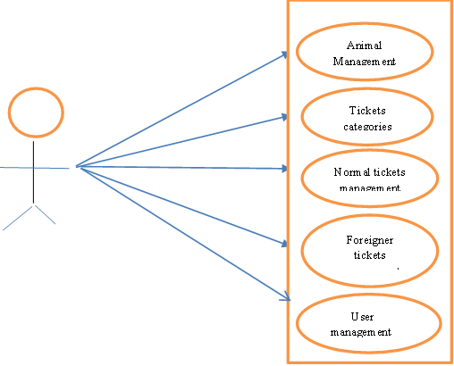
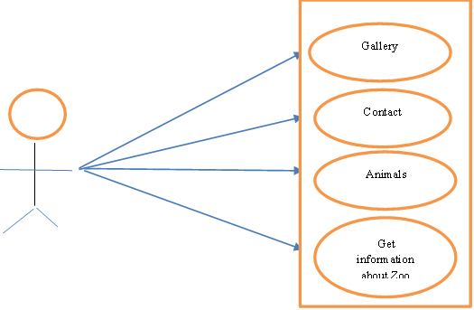
ADMIN CASE DIAGRAM
USER CASE DIAGRAM
Fig-5: Admin case diagram.
Fig-5: User case diagram.

Slide 16
ADVANTEGES
Manage Data of Animal.
Manage Tickets data.
Create new User for admin Dashboard.
Delete new User Existed in Admin dashboard.
Add Admin. &Delete Admin.
There is no paper work to lost data also saved trees.
Data about animal quickly find out.
If anyone has a problem they can directly contact with zoo.
It is helps to grow our tourism industry.

Slide 17
Applications
Useful in Cow Shed.
Can use in Zoological gardens.
Can Use in Botanical Gardens.
Also use as Government Tourism site.
Useful in Tiger Reserves.
Useful in Bird sanctuary

Slide 18
CONCLUSION
Its all about managing Zoological garden and gather information about the kingdom animalia , their behavior, their habitats .
This zoo management system supports zoo managements, teachers, NGOs and others who use zoos as educational facilities.
blog section shares peoples experiences

Slide 19
REFERENCES
http://nationalzoo.si.edu/
CEE’s Zoo Education programmes
Software Engineering: Roger Pressman
Asp.net: www.c-sharpcorner.com
MS-SQL Server: www.w3c.com

Slide 20
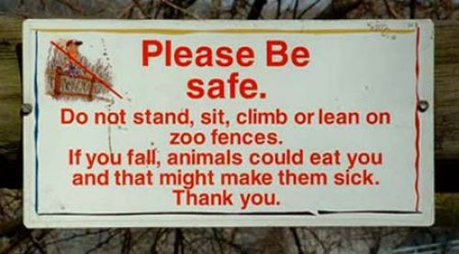
THANK YOU

